Slide 1

Azure Service Bus
Justin Saraceno

Slide 2
About Me
Co-organizer Triangle .NET User Group (TRINUG)
Co-organizer of Raleigh Code Camp
Dev team lead
Twitter: @JustinSaraceno Email: Justin.Saraceno at gmail Web: JustinSaraceno.com

Slide 3
The next 45 minutes
What is a Service Bus?
Why would you want to use a Service Bus?
Create an Azure Service Bus Publisher
Consume the Azure Service Bus (and not just with .NET)

Slide 4
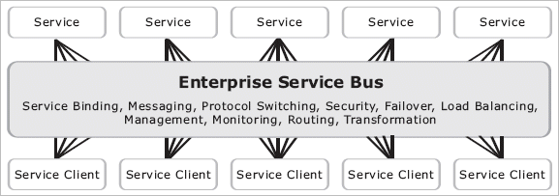
What is a service bus?

Slide 5

What is a service bus

Slide 6




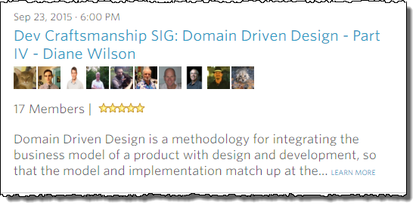
Domain driven design

Slide 7
Justin’s widget company

Slide 8
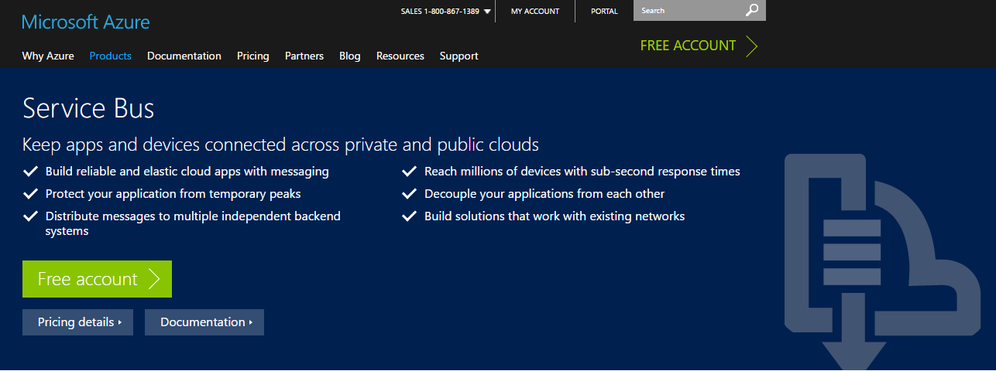
Back to azure service bus…

Slide 9
Azure Service Bus Capabilities
 | Azure Queues | Azure Service Bus
Ordering Guarantee | No | FIFO
Received By | First Subscriber | All Subscribers
Durable client-side queue
Failover across multiple datacenters
Datacenter replication
It’s a utility!

Slide 10
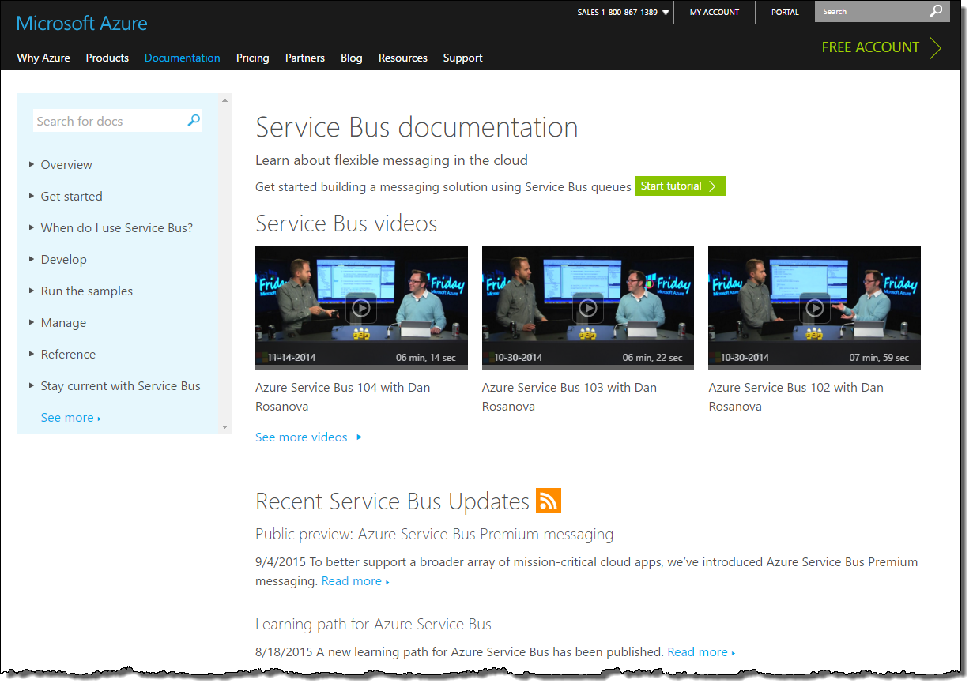
Getting started

Slide 11

Demo

